Slide 1
Current Issues for Local Schools Budget and Financial Reporting
Alabama association of school business officials (aasbo) LOCAL SCHOOL FINANCIAL MANAGEMENT NOVEMBER 8, 2021
Karen C. O’Bannon, CSFO Madison county schools kobannon@mcssk12.org

Slide 2
Budgeting for Activity Funds
Budgeting is the process of planning resources and prioritizing needs of an organization. In most cases, for a governmental entity the budget represents the legal authority to spend money.
The budget also provides an important tool for the control and evaluation of resources and the uses of those resources. It is a tool to evaluate financial performance by comparing budgeted and actual operations. Bottomline, the budget is linked to financial accountability.

Slide 3
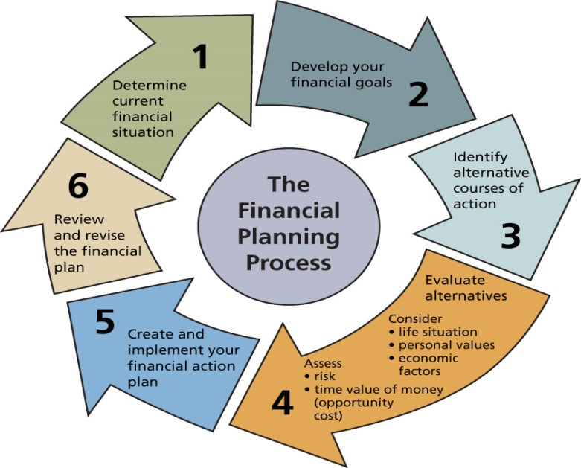
Budgets
Provide a financial plan for the organization
Important at all levels of any organization
Critical element for success
Assess financial condition
Create roadmap for future

Slide 4
Mission of Budget Process
The mission of the budget process is to help decision makers make informed choices about the services and needs of a particular activity or local school function as well as overall planning for general operations.

Slide 5
Lines of Authority
Board of Education. The Board of Education adopts policies to govern the establishment and operation of all activity funds. The District’s auditors review these policies for sound accounting controls and reporting principles.
Superintendent. The Superintendent is directly responsible to the Board of Education for administering all Board policies.
Chief School Financial Officer. The Chief School Financial Officer has the overall responsibility for accounting for and reporting all funds, including district and student activity funds, to the Board. The Chief School fFnancial Officer is also responsible for implementing and enforcing appropriate internal control procedures.
Principal. The Principal at each school site is designated as the activity fund supervisor for that individual school. The activity fund supervisor has overall responsibility for the operation of all activity funds, including collecting and depositing monies; approving disbursements of student activity fund monies; and supervising all bookkeeping responsibilities. The activity fund supervisor should be a signatory for all disbursements.

Slide 6
Fiduciary Responsibility of the Principal
Ultimately it is the Principal’s responsibility to ensure that funds are collected and disbursed in accordance with local board policies.
The Principal should be familiar with the Financial Procedures for the School District to have a basic understanding of the accounting regulations for schools.
The Principal should work with the bookkeeper and staff when preparing the local school annual budgets.

Slide 7
Finance Matters/Budget Process General Outline
Example: Madison County Board of Education
February – Pre-Staffing Meetings (Central Office Leadership Team)
March ~ April – Staffing Meetings (Leadership Team and Local School Principals)
April ~ May – Monitoring and Tracking Legislative Session (State Funds)
May – Local School Budget Preparation
June – Reviewing and Uploading Local School Budgets
Rolling and Entering Personnel Costs
July – Departmental Meetings and Non-Personnel Cost Entries
August – Federal Programs and Final Budget (1st Public Budget Hearing)
September – Board Approval and Submission to SDE (2nd Public Budget Hearing)

Slide 8
Budget Overview – Fund Types:
General Fund – State and Local Sources
Special Revenue Funds – Federal Programs and PUBLIC LOCAL SCHOOL FUNDS, (Appropriations, Admissions, Concessions, Dues and Fees, Fund Raisers, Grants, and Donations)
Debt Service Funds – State and Local Funds Set Aside for Annual Debt Payments
Capital Projects Funds – State Fleet Renewal Funds, State Capital Funds, and Local Bond Proceeds
Fiduciary Funds – NON-PUBLIC LOCAL SCHOOL FUNDS (Club Fees, Fund Raisers, Donations, and Accommodations)

Slide 9
Activity Fund Accounting/Budgeting for Local Schools
Before the AASBO LSFM Program, not enough attention was given to accounting for activity funds in school districts. The nature of activity funds, however, makes them especially vulnerable to error, misuse, and sometimes fraud. In addition, activity funds often generate large sums of money, especially when capturing the amount that flows through a local school in the form of school board funds, student-generated funds, receipts and disbursements related to athletics, and the numerous co curricular and extracurricular events sponsored by school districts today.
We are seeing a change statewide. School districts as well as local school administrators and staff are doing a much better job planning, budgeting, and tracking local school accounts.

Slide 10
Summary – Elements of the Budget Process
Develop a Budget Consistent with Goals
Develop a process for preparing and adopting a budget/communication
Evaluate financial resources and prioritize needs
Prepare budget based on decisions from team
Evaluate Performance
Monitor, measure, evaluate, and report
Adjust or amend if necessary

Slide 11
State Appropriated
“Classroom Instructional
Support” Funds

Slide 12
State Appropriated “Classroom Instructional Support” Funds
Student Materials
Technology
Professional Development
Library Enhancement

Slide 13
State Appropriated “Student Materials”
2021-2022 allocation is $700.00
Not subject to vote; funds directly to teacher/certified employee
Instructional equipment is permissible
Furniture to store/safeguard the equipment is permissible
Copy paper is permissible (when used for classroom instruction)

Slide 14
State Appropriated “Technology”
2021-2022 allocation is $500.00
Requires majority vote of faculty
Technology specialists should be consulted
Should be consistent with the latest plans for system-wide technology plan

Slide 15
State Appropriated “Professional Development”
2021-2022 allocation is $100.00
Requires majority vote of faculty
Should be consistent with the latest system-wide plans for professional development
Registration fees permissible
Professional memberships permissible
Professional Development Presenters/Speakers permissible

Slide 16
State Appropriated “Library Enhancement”
2021-2022 allocation is $157.72
Requires majority vote of faculty
Media specialists should be consulted

Slide 17
Budget Committee
Each school must have a budget committee
The budget committee must be comprised of 5 members
Principal (or designee)
4 Teachers
Elected Annually
Voting by Secret Ballot
Majority Vote
A list of elected committee members shall be provided to the CSFO
A sign-in sheet shall be maintained to document faculty members attending the budget committee meeting

Slide 18
Proposed Budget Approval by Teachers
The committee must elect:
Chairperson
Secretary
Responsible for keeping minutes and actions taken to approve the budgets during the secret balloting process
The committee may for advisory committees
The committee must propose a budget for CIS, excluding student materials/fee replacement monies

Slide 19
Approval of Budgets
Proposed budgets must be submitted to teachers at an annual meeting
A sign-in sheet shall be maintained to document faculty members attending the annual meeting at which the budget is presented
Teachers must be given at least two workdays to review the proposed budget prior to taking a vote
Voting must be by secret ballot
Budget must be approved by majority vote

Slide 20
Proposed Budget Approval (cont’d)
If not approved, returned to committee for reformulation, taking into consideration the teachers’ recommendations
Revised budget proposed by committee submitted to a secret ballot voted of the teachers
If the revised proposed budget is not approved by a majority vote of the teachers, the process will continue until a budget is approved

Slide 21
Proposed Budget Approval (cont’d)
A report on the approved budget will be submitted to the local Superintendent on forms provided by the State Department of Education. These forms shall be signed by all committee members
The following must be maintained for audit
budget committee minutes
proposed budgets
revised proposed budgets
secret ballots for committee members
secret ballots for each proposed budget
secret ballots for each revised proposed budget
All expenditures for CIS and related documents are subject to audit by the State Examiners of Public Accounts

Slide 22
Teacher Transfer
Classroom instructional support monies are to be expended on behalf of students at a specific school and are not transferred with the teacher if he/she moves to another school.

Slide 23
Unspent Funds
Any funds appropriated for classroom instructional support not expended by the end of each fiscal year shall revert to the State Education Trust Fund.

Slide 24
Questions?

