Slide 1
PERSONNEL MANAGEMENT
The Employment Process - AASBO
November 1, 2021
Mary Veal, Director of Human Resources
Hoover City Schools

Slide 2
HIRING PROCESS
Position is Vacated
Post Position
Select Candidates to Interview
Interview Process
Vetting
Hiring Recommendation Process

Slide 3
Job Posting
The Job Description provides clarity on minimum job requirements including duties and responsibilities
Vacancies must be posted for at least 7 calendar days
Vacancies involving jobs which are supervisory, managerial, or otherwise newly created positions, require posting notices of at least 14 calendar days
“Potential” vacancies can be posted in advance, even if a resignation has not been received

Slide 4
Job Posting
The notice shall include, but not necessarily be limited to, the following:
Job description and title
Required qualifications
Salary schedule and amount
Information on where to submit an application
Information on deadlines for applying
Any other relevant information
Alabama Code Title 16-22-15

Slide 5
Selecting Candidates to Interview
Review applications and determine who does not meet the minimum job requirements for the position
Teach In Alabama allows a hiring manager the option to select certain criteria to reduce the number of eligible candidates
Analyze characteristics and diversity of the team, department, grade level, etc., to assist in identifying candidates who would work well with that group

Slide 6
Selecting Candidates to Interview
Experience can be an important factor in some instances
Having a team of diverse individuals to review applications is a good practice
Some hiring managers may look for candidates that are similar to them

Slide 7
Hiring Considerations
HIRING FOR ATTITUDE, by Mark Murphy, examines cutting-edge practices to hire the best candidates for a position. Murphy states that:
When new hires fail, 89% of the time it is for attitude and not a lack of technical skills
Highly skilled is not always highly effective
General interview questions do not always assess attitude, coachability, motivation, and temperament
When interviewing, most managers ask too many questions, forcing applicants to give fast and superficial answers

Slide 8
Interview Panels
Establish a screening/interview process that includes who and how many individuals should participate
Review appropriate questioning methods, confidentiality, and selection procedures with interview participants
Determine how a final recommendation will be determined
All personnel actions have to be recommended by the Superintendent to the Board for final approval

Slide 9
Vetting Employees
You can’t always trust what is on a resume
Questions to consider when checking REFERENCES :
How recent are the references?
Did any immediate supervisors submit a reference?
What relation is the applicant to the reference?
What length of time did the reference work directly with the applicant?

Slide 10
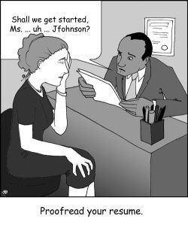

Slide 11
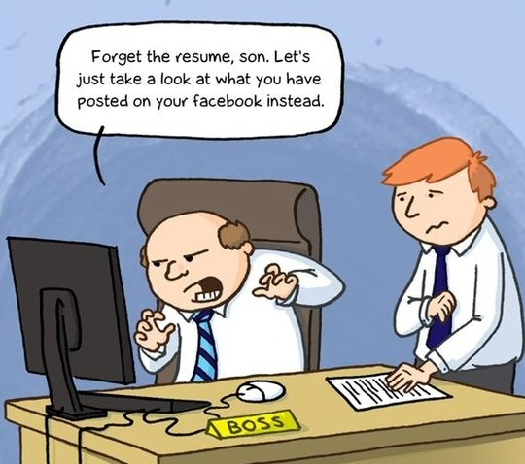

Slide 12
Vetting Employees
The ALSDE online application system, Teach In Alabama, keeps all references on file from the initial time of application
Contact current employer for further vetting
Look beyond technical skills or knowledge, and areas where references have less favorable ratings
Google and social media have become popular vetting tools

Slide 13
Vetting Employees
Read entire APPLICATION thoroughly to examine reasons the applicant left previous job or was non-renewed for cause
Look for attachments that may be included in application such as additional reference letters, certification information, etc.
Check conviction history and background questions
Check employment history for gaps in employment or changing positions frequently

Slide 14
Background Checks
All Alabama public education employees must complete a background check through the ALSDE system (excludes volunteers)
Applicant registers and pays for background check online, and chooses a location listed to complete the fingerprinting process
If no significant charges or convictions surface, the results could be returned within 24 - 72 hours
If an applicant has serious convictions, he/she must submit a case summary to the ALSDE; the ALSDE sends results to the school system who makes a determination of whether to hire or not

Slide 15
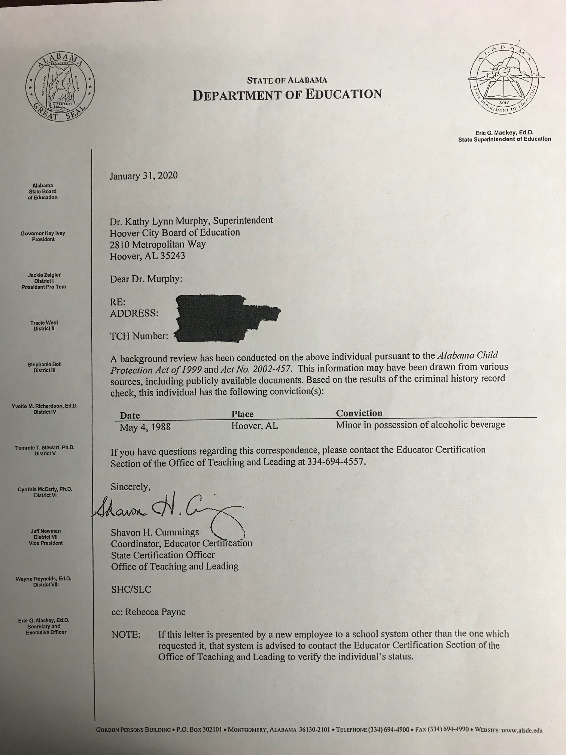

Slide 16
Pre-Employment Forms - Examples
Copy of Driver’s License
Social Security Card or Passport (E-Verify)
USCIS Form I-9
A-4 and W-4 Tax Forms
Direct Deposit Authorization or Letter from Banking Institution
Alabama Teachers Retirement Systems (TRS) Enrollment Form
RSA Post-Retirement Employment Form (if applicable)
Personal Leave Day Options
Sick Leave Bank
Vacation Policy
Employee Handbook Agreements/Acknowledgements

Slide 17
Pre-Employment Information
Work Verification from Previous Employers
Sick Day Transfer Requests
Transcripts (Certified Personnel)
Proof of Pre-employment Drug Screening (Transportation Personnel)

Slide 18
I-9 E-Verify
E-Verify is a web-based system to confirm eligibility of employees to work in the United States. The system verifies information that is submitted on the I-9 Form and E-Verify, against records available to the Social Security Administration (SSA) and the Department of Homeland Security (DHS).
Must be completed within three business days of official start date
Employers cannot specify which I-9 documentation employees must present
E-Verify Notices must be posted in English and Spanish

Slide 19
Affordable Care Act Notice
Employment information must contain the Affordable Care Act (ACA) Notice that informs employees of the Health Insurance Marketplace to find and compare private health insurance options.
ACA options are more applicable to individuals not receiving health insurance through an employer by qualifying for federal subsidies described in the notice
PEEHIP coverage is considered “affordable” according to ACA rules

Slide 20
Employment for Individuals 18 and Younger
The Alabama Department of Labor requires an EMPLOYEE INFORMATION FORM (located at www.labor.alabama.gov) to be on file with anyone 18 years or younger at the premises where employees 18 years and younger are employed.
Proof of age documentation
An ELIGIBILITY TO WORK FORM is required for minors age 14 and 15
Time records must be maintained
Child Labor Certificates must be in public view and renewed annually

Slide 21
The Alabama Child Labor Law
Minors under the age of 18 may be prohibited from working in certain conditions
Minors 16, 17, and 18 who are enrolled in public or private school shall NOT work between 10 p.m. and 5 a.m. on any night preceding a school day
Minors 14 and 15 shall not work before 7 a.m. and 7 p.m. any day of the week, during hours when school is in session, no more than 3 hours on school days, no more than 8 hours on non-school days, and no more than 18 hours/week
Minors 14 and 15 have different summer months rules

Slide 22
New Hire Orientation
Many HR and/or Payroll Departments provide new hire orientation to review school district policies and review benefits prior to Open Enrollment. Other information to consider reviewing during the onboarding process is below:
Confidentiality of personnel files
Anti-discrimination & harassment policies
On-the-Job Injury (no workers compensation)
Leave of absence procedures (No FMLA eligibility first year of employment)
Time clock or absence management procedures
Employee Assistance Program (if available)
Tenured/Non-probationary laws
Educators Liability Trust Fund (ELTF)

Slide 23
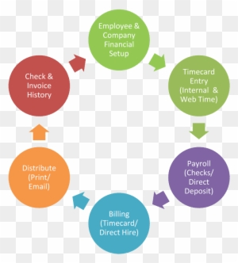
HR AND PAYROLL COLLABORATION
Payroll & Benefits

Slide 24
HR AND PAYROLL
Onboarding
Attendance monitoring
Leave administration
Substitute management
Salary and work experience
Separation of employment
Disability claims

Slide 25
Questions?
Mary Veal, Director of Human Resources
Hoover City Schools
mveal@hoover.k12.al.us

